Slide 1

Healthcare Analytics
Group 1 : Project Team
Pawan Kumar Patnaik
Ummadi Lakshmi Narasimha Reddy
Sreevaishnavi K
Varsha Pappusingh Inda
Saish Dinesh Gondhalekar
Sweta.Vishal.Lali
Divya V

Slide 2

Project Overview
The Healthcare Analytics project aims to provide insights into patient demographics, treatment outcomes, and operational efficiency using real-world healthcare data. The objective is to identify key performance indicators (KPIs) that can support data-driven decisions to improve patient care and optimize healthcare services.
Key Goals:
Monitor patient health statistics
Analyze treatment success rates
Understand resource utilization
Track revenue and cost trends

Slide 3

Key Performance Indicators (KPIs)
Total Patients
Total Doctors
Total Visits
Average Age of Patients
Top 5 Diagnosed Conditions
Follow-Up Rate
Treatment Cost Per Visit (Avg.)
Total Lab Tests Conducted
Percentage of Abnormal Lab Results
Doctor Workload (Avg. Patients Per Doctor)
Total Revenue

Slide 4
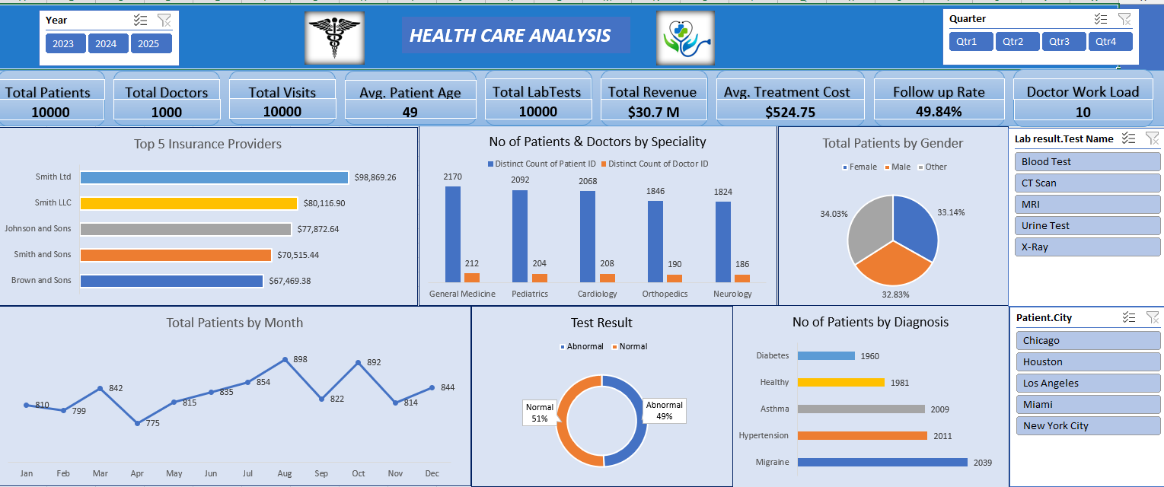
Excel

Slide 5
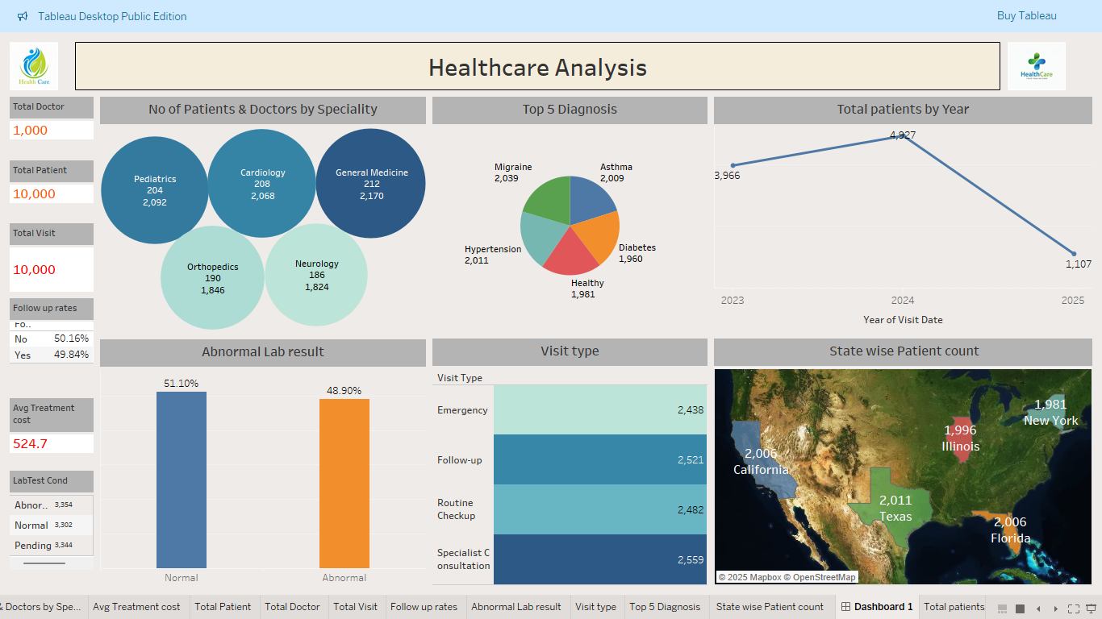
Tableau

Slide 6
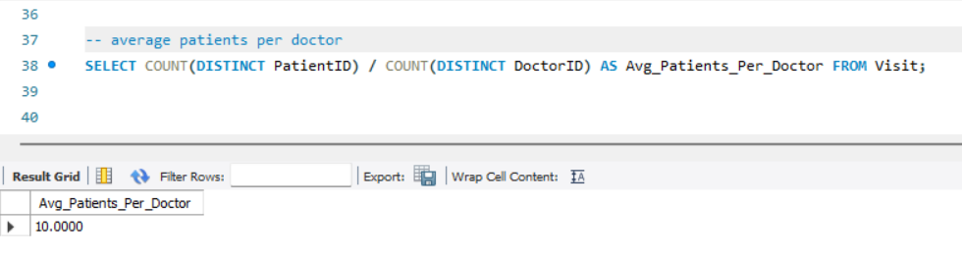
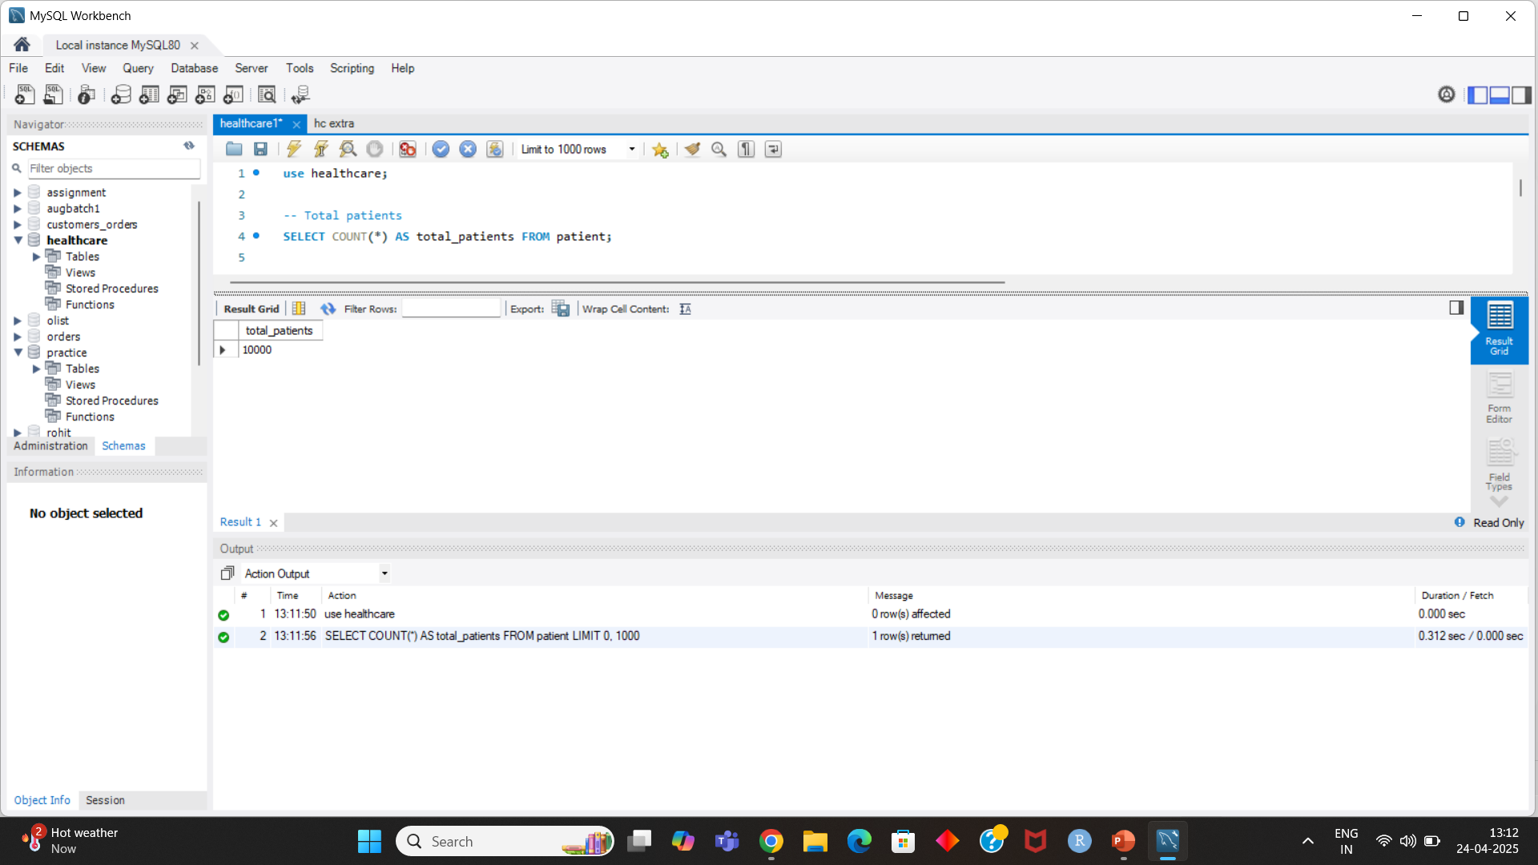
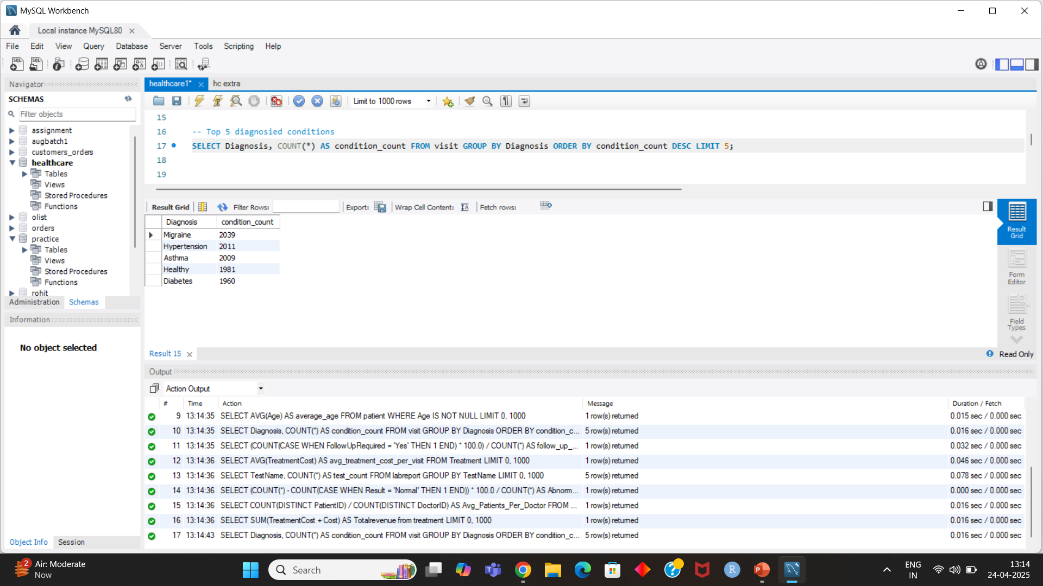
MySQL

Slide 7
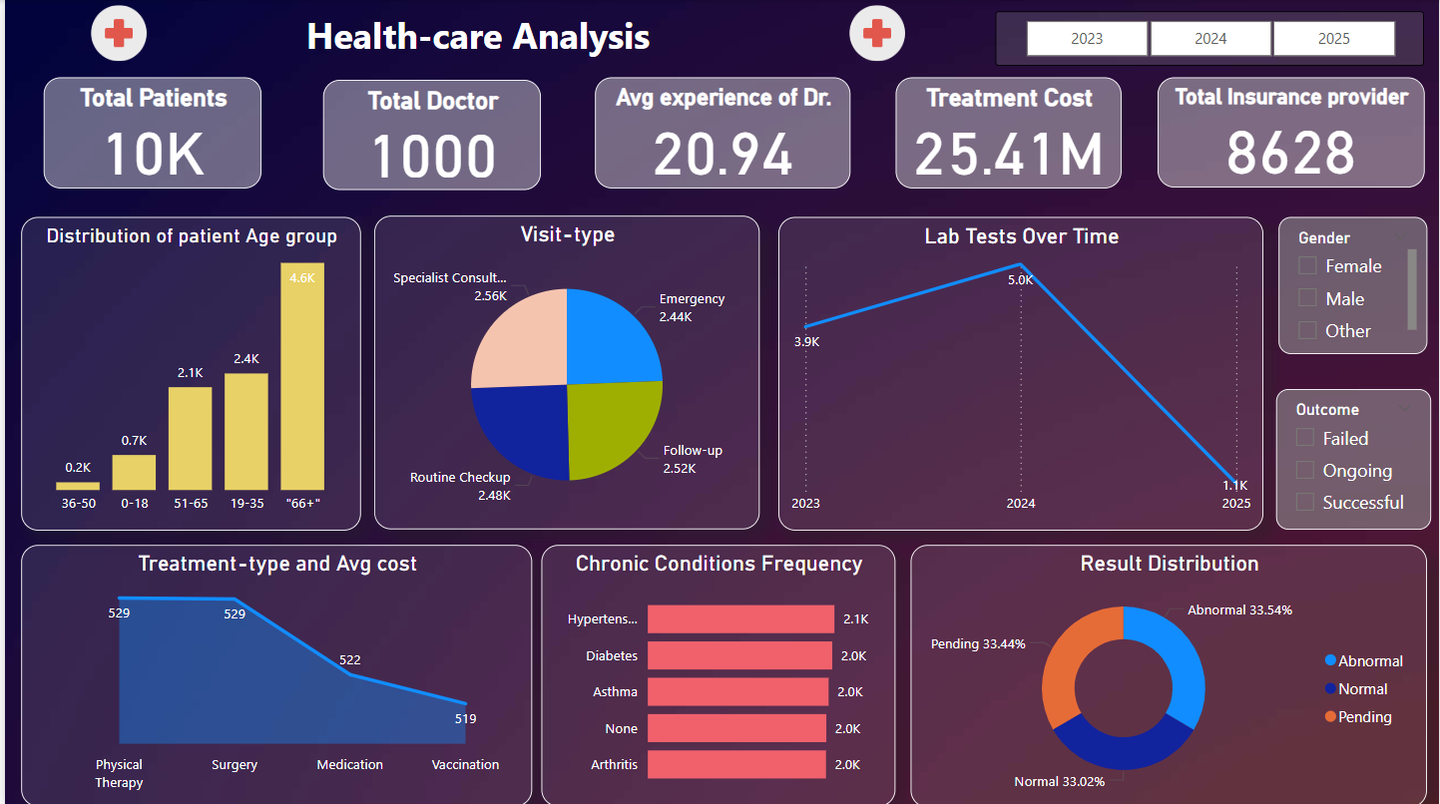
Power BI

Slide 8
Challenges Faced
Challenges:
The data was unclear and required additional time for processing.
Different KPIs needed various visualization formats (e.g., line charts, bar graphs, maps), making the selection process difficult.
Importing the dataset into MySQL was slow, and column renaming and date format issues added complexity.
Manual tasks in Tableau for creating visualizations were time-consuming.
Resolutions:
Used the ‘load data infile’ method for faster data loading into SQL.
Focused on key priorities, simplifying aesthetics to enhance clarity.
Gained a clear understanding of the data needed for each KPI visualization.
Removed duplicate or less valuable information to streamline the process.

Slide 9
Key take aways
1
The project showcases the transformation of healthcare data into actionable insights using analytics tools
2
Key Performance Indicators (KPI) play a crucial role in accessing healthcare performance
3
Hospitals can use analytics to enhance service quality and improve patient outcomes
4
Efficient use of data helps in managing and reducing operational cost effectively

Slide 10
Thank You

